Slide 1
MARKETING LECTURE # 19 MUHAMMAD ASAD INSTRUCTOR DEPARTMENT OF COMPUTER SCIENCE

Slide 2
Key Learning Point :-
- Discussion about the market Mix

Slide 3
Marketing mix means the set of various marketing tools --- Used by an organization to achieve the desired objectives of marketing.
In an organization, various decisions regarding to marketing strategy --- Are affected by a large number of factors --- Some of which are controllable, while the others are non-controllable.

Slide 4
CONTROLLABLE FACTORS refer to factors which can be controlled by the organization --- Such as price, branding, advertising and etc.
NON-CONTROLLABLE FACTORS refer to factors which cannot be controlled by the organization --- Such as government policies, inflation or the policies of commercial banks and etc.

Slide 5
To achieve the various objectives of marketing strategy --- An organization continuously alters the various controllable factors --- These factors, also known as marketing tools, form the basic pillars of marketing.
From the various available marketing tools --- an organization chooses the most suitable and best combination.
This combination of marketing tools used by the organization is called a marketing mix.

Slide 6
PRODUCT
GOODS & SERVICE COMBINATION THAT A COMPANY OFFERS A TARGET MARKET
PRICE
AMOUNT OF MONEY THAT CONSUMERS HAVE TO PAY TO OBTAIN THE PRODUCT
MARKETING MIX
ELEMENTS
PLACE
COMPANY ACTIVITIES THAT MAKE THE PRODUCT AVAILABLE
PROMOTION
ACTIVITIES THAT CONVINCE TARGET CUSTOMERS TO BUY THE PRODUCT

Slide 7
PRODUCT
A product is anything of value --- A good or service offered to a market to satisfy needs or wants.
In terms of marketing…
Product refers to the mix of various tangible and intangible attributes of a good or service which have a value and can be exchanged --- They are capable of satisfying the needs of consumers.

Slide 8
A product is defined not only --- In terms of physical product (functional utility) --- But also in terms of satisfaction or utility provided to the consumer --- After sales services --- Such as, customer care, addressing consumer complaints and taking feedback are also part of the product.
TYPES OF UTILITIES / SATISFACTION OFFERED BY A PRODUCT
A consumer derives satisfaction from the consumption of a product --- So, when a customer decides to purchase a product --- His / Her main focus is on the utility which he would receive on consuming it.

Slide 9
A customer derives utilities / satisfaction / benefits from the consumption of a product
FUNCTIONAL UTILITIES / SATISFACTION / BENEFITS
The utility derived from the basic functions performed by the product.
FOR EXAMPLE
A cooking gas range provides functional utility as a medium of cooking.

Slide 10
PSYCHOLOGICAL UTILITIES / SATISFACTION / BENEFITS
The utility derived in the form of pride and self-esteem owning the product.
FOR EXAMPLE
A consumer can derive psychological benefit from owning a cooking gas range which he / she uses as a modern means of cooking.
SOCIAL UTILITIES / SATISFACTION / BENEFITS
The utility derived in the form of acceptance among the peer group --- Such as consumption or use of a particular product.

Slide 11
PRODUCT MIX
Essential decisions related to product quality, design, packaging and variety, and etc. --- That a producer offers to the market.
COMPONENTS OF PRODUCT MIX
1: BRANDING
2: PACKAGING
3: LABELLING

Slide 12
1: BRANDING
The process of giving a unique name, sign, symbol or term for the identification of a product --- The name can be either a generic name or brand name.
The brand name acts as a basis of differentiation of the organization’s product with that of its competitors.
Generic name --- Name of the whole class of products --- Generic names cannot be owned by anyone, not even by the firm who first introduced them.

Slide 13
GENERIC NAME
Name of the whole class of products --- Generic names cannot be owned by anyone --- Not even by the firm who first introduced them.
BRAND NAME
Different name given to the product so that it can be differentiated from other products --- A brand is an identifying symbol, mark, logo, name, word, sentence. (Apple, Google, Microsoft, Amazon, and Facebook were the most valuable brands)

Slide 14
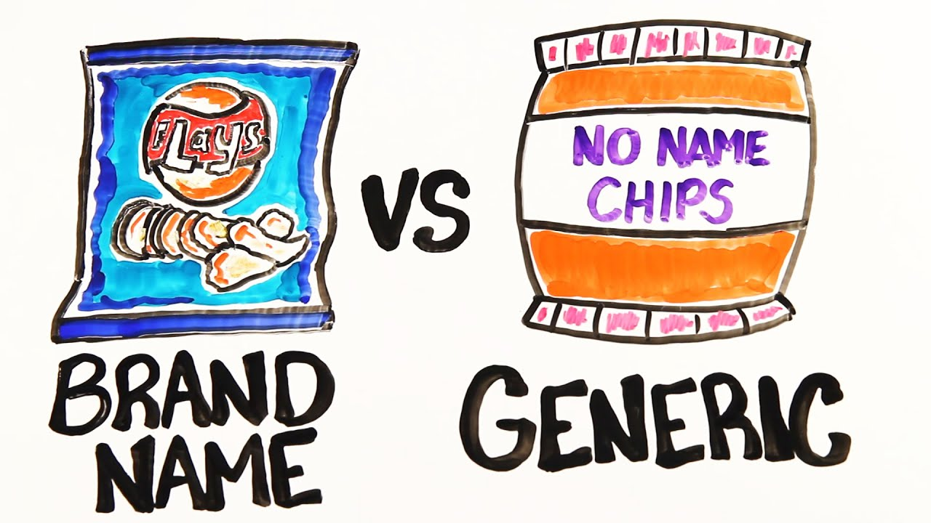

Slide 15
TERMS RELATED TO BRAND
BRAND --- Name, term, sign, symbol, design or combination of them used to differentiate the product from competitors’ products. Such as, cars make by Toyota, Honda, Suzuki, KIA, Hyundai and etc.
BRAND NAME --- Verbal part of brand which can be spoken. Such as, paint Companies Master paints, Happilac Paints, Brighto Paints, Nippon Paints, Diamond Paints and etc.
TRADE MARK --- Part of brand which has legal protection so that no other firm can use such name or mark. The golden arches of McDonald's® is an example of a design that is a registered trademark.

Slide 16

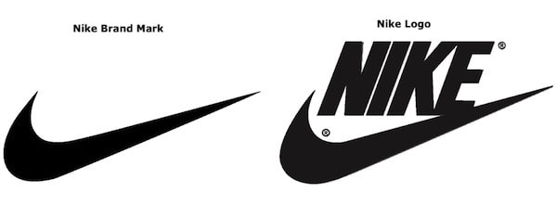
BRAND MARK --- Part of brand which can be identified but cannot be spoken (visual elements, images, symbols, and other identifying features of a company's brand that help it stand out from other businesses). Symbols and icons can also be helpful in communicating supplementary information about a company or its brand.

Slide 17
CHARACTERISTICS OF A GOOD BRAND NAME
SIMPLE AND SHORT --- The name should be simple and short that it is easy to spell and pronounce and people are able to remember it. Such as, Pepsi, Coke and etc.
UNIQUE --- The name should be unique in all aspects. Also, it must be suitable to the requirements of packaging, labelling and advertising.
LEGAL PROTECTION --- A brand name must be as such that it can be registered and hence can obtain legal protection.

Slide 18

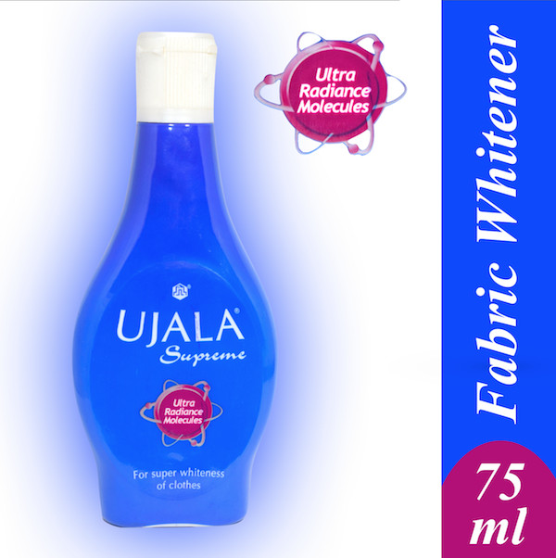
SELF-EXPLANATORY --- The name should be self-explanatory in the sense that it must provide an idea of the use, benefits and qualities of the product. Such as, Ujala, Twitter and etc.

Slide 19
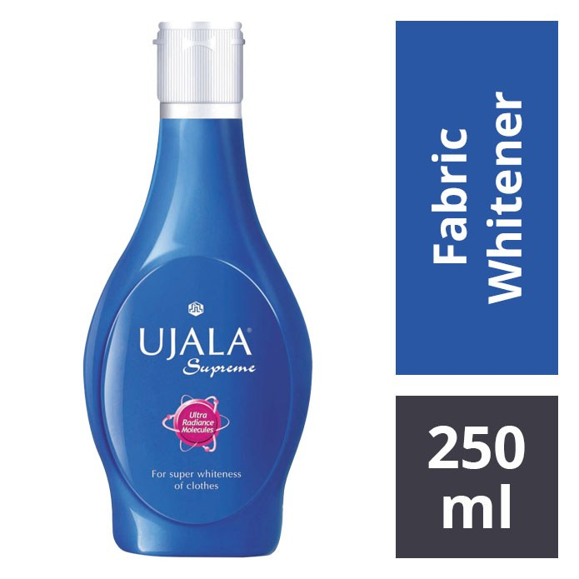
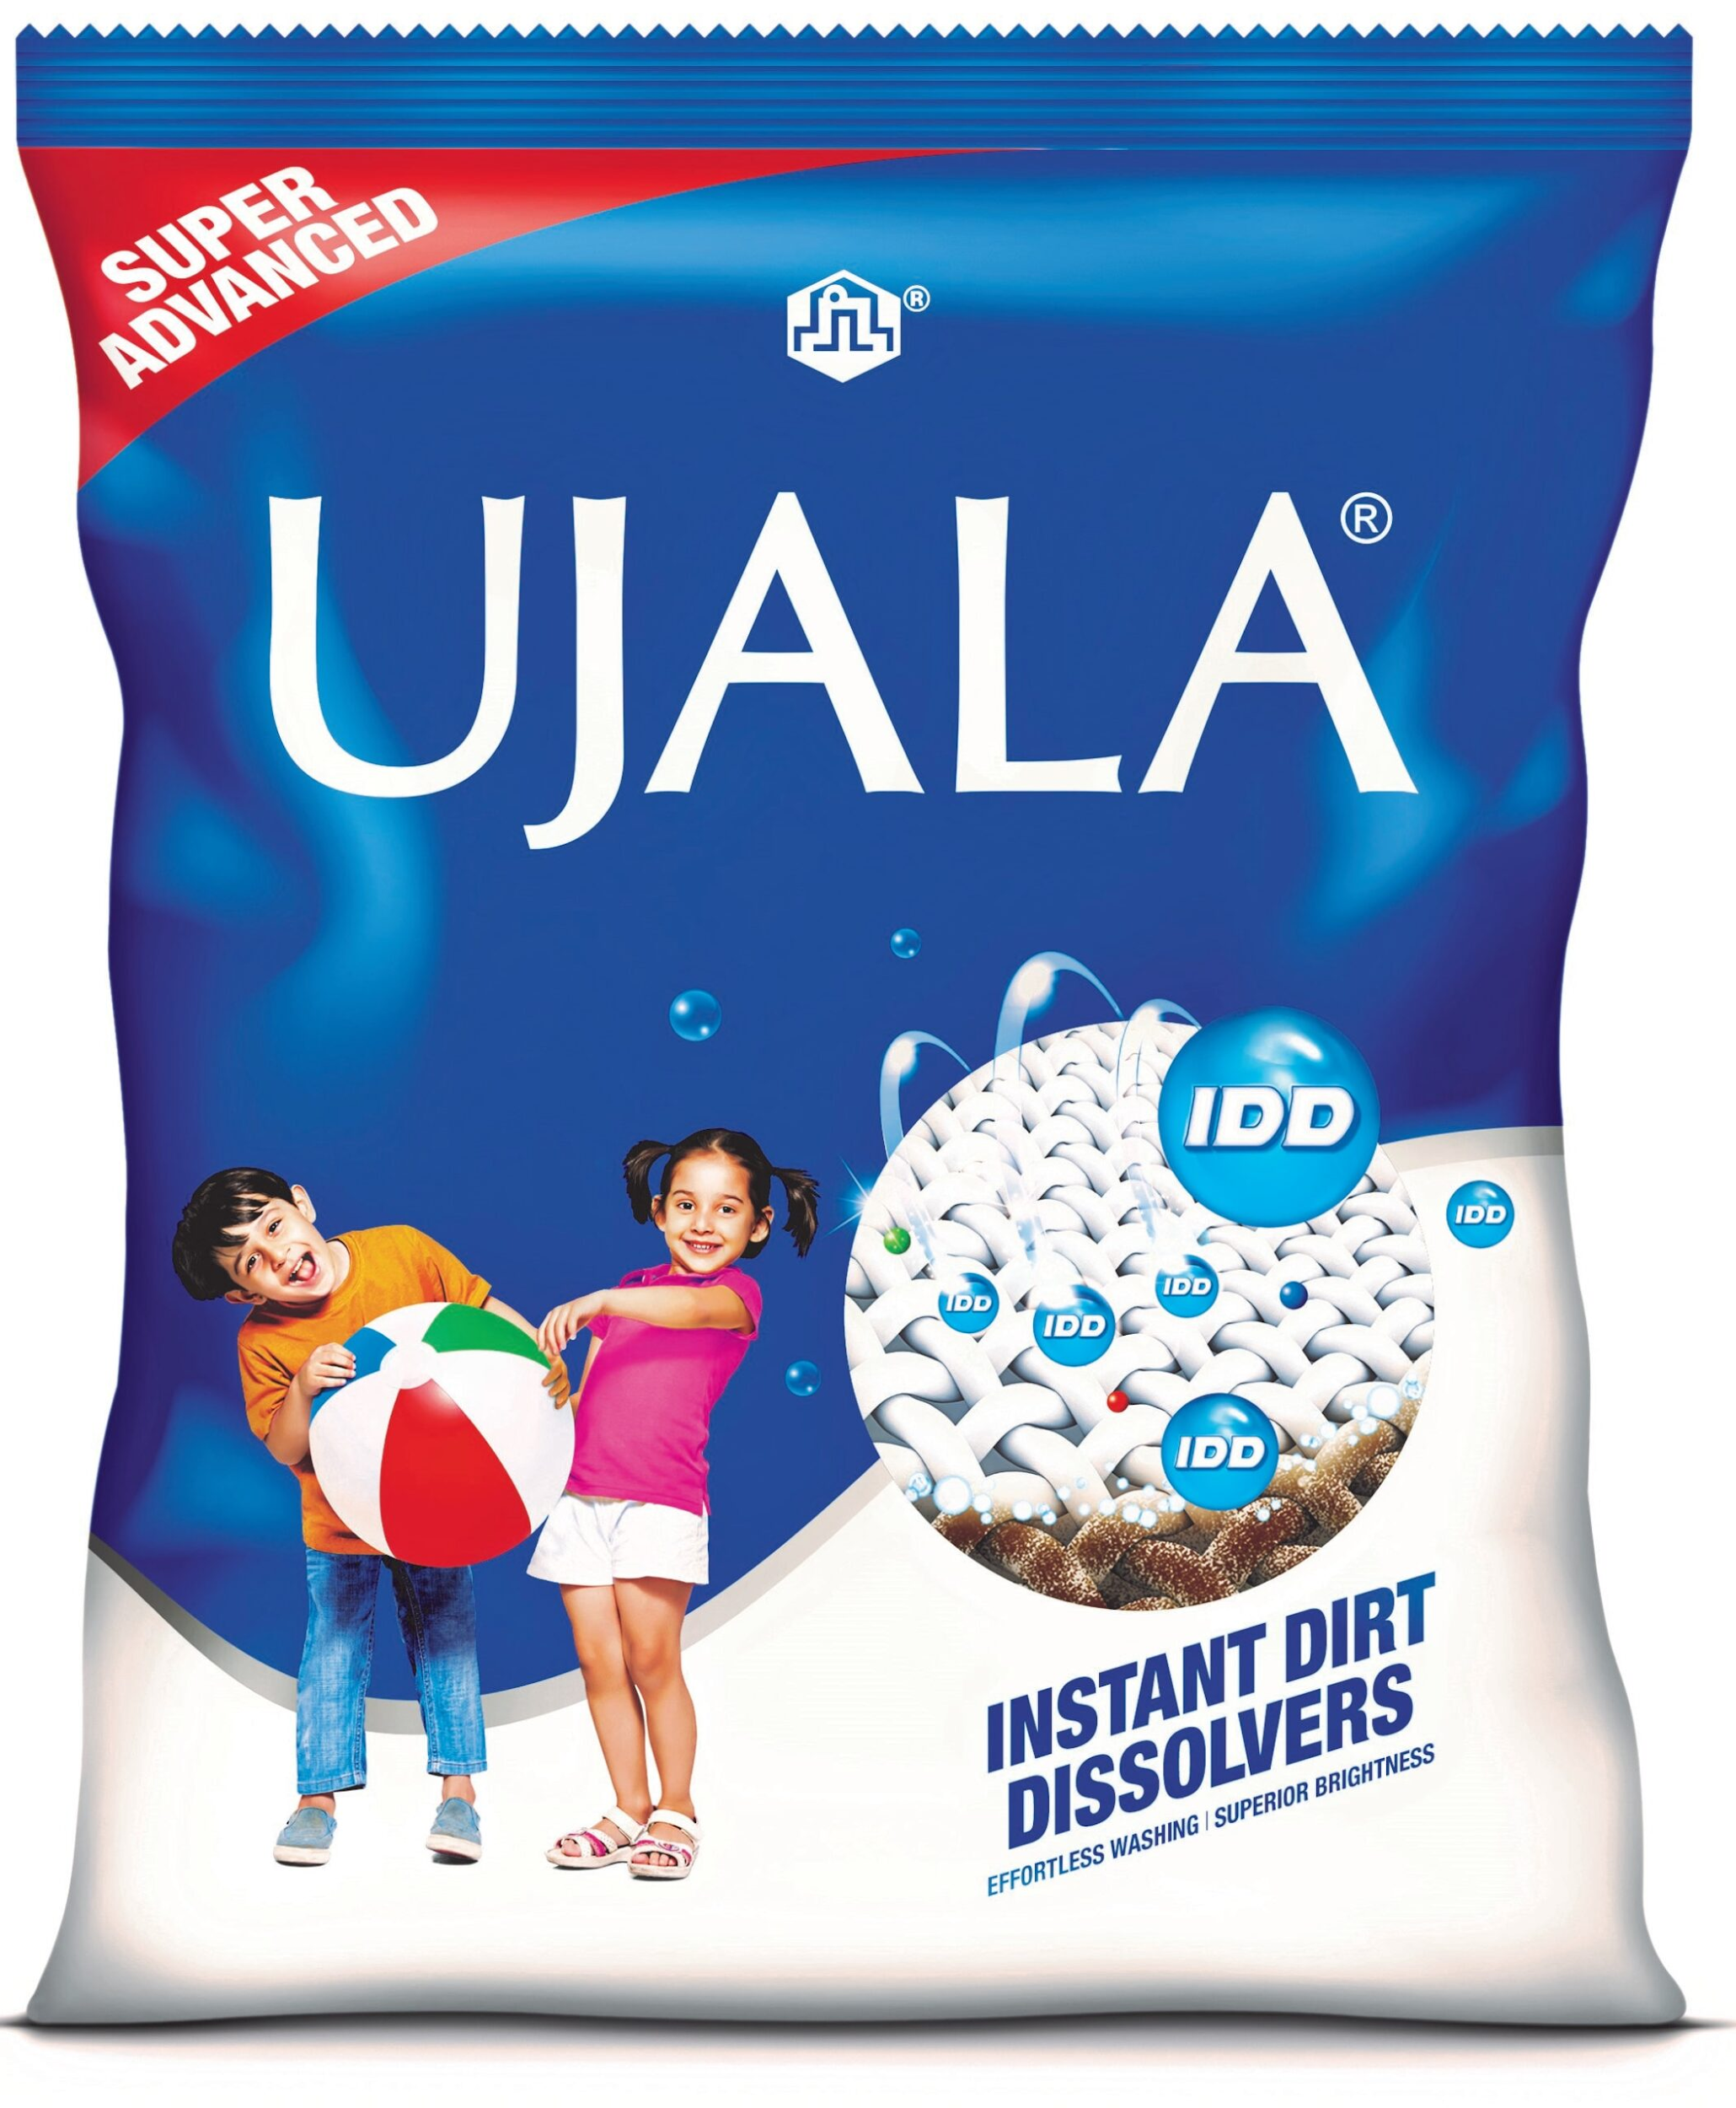
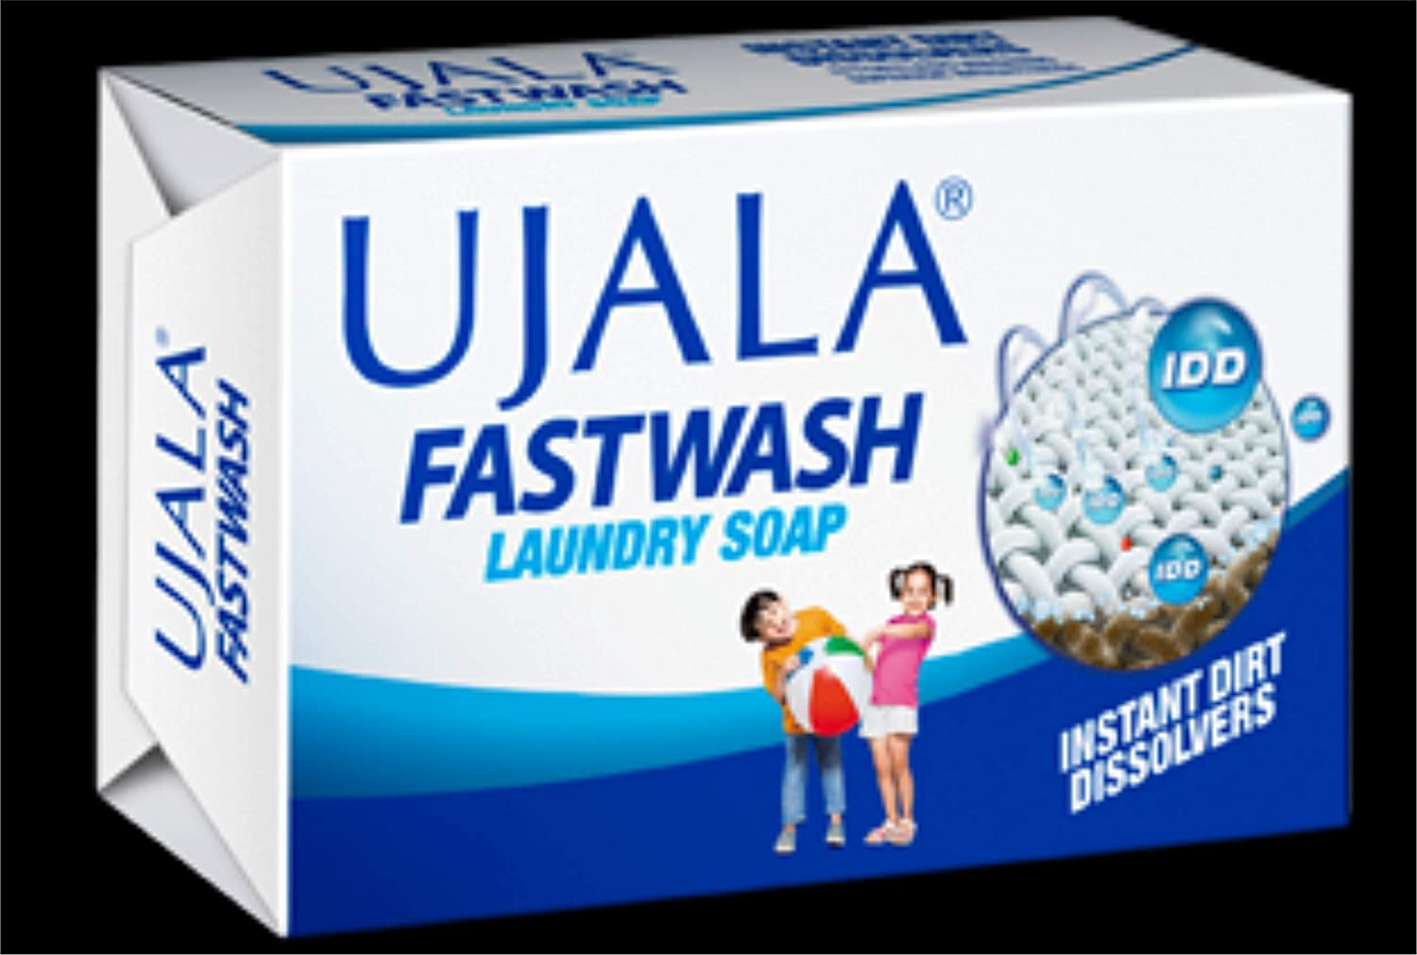
ADAPTABLE --- A brand name should be adaptable in the sense that if required a new product can also be introduced under it.

Slide 20
ADVANTAGES OF BRANDING TO MARKETERS OF GOODS AND SERVICES
HELPS IN PRODUCT DIFFERENTIATION --- Branding enables a business organization to differentiate its product from that of its competitors. In this way, it enables a certain degree of control over the market.
HELPS IN ADVERTISING --- It enables advertising of the product. Without branding, advertising cannot be done.

Slide 21
DIFFERENTIAL PRICING --- Branding enables a business organization to follow differential pricing strategy. That is, it allows the organization to charge a different price than that charged by its competitors.
EASY INTRODUCTION OF NEW PRODUCT --- Branding of an existing product forms the base for the introduction of new products by the organization. This is because a new product would get a boost and benefit from the reputation of the existing brand.

Slide 22
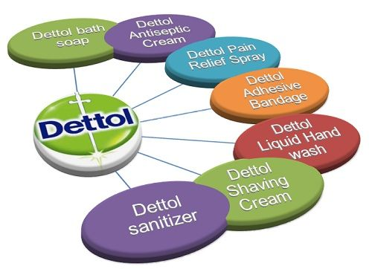

Slide 23
ADVANTAGES OF BRANDING TO CUSTOMERS OF GOODS AND SERVICES
PRODUCT IDENTIFICATION --- Enables consumers to clearly distinguish and identify the product among various other products provided by competitors.
ENSURES QUALITY --- Brand is seen by consumers as a mark of authenticity and quality assurance. (Nestle products vs Local brand products --- TCS Courier service vs Other Courier service)

Slide 24
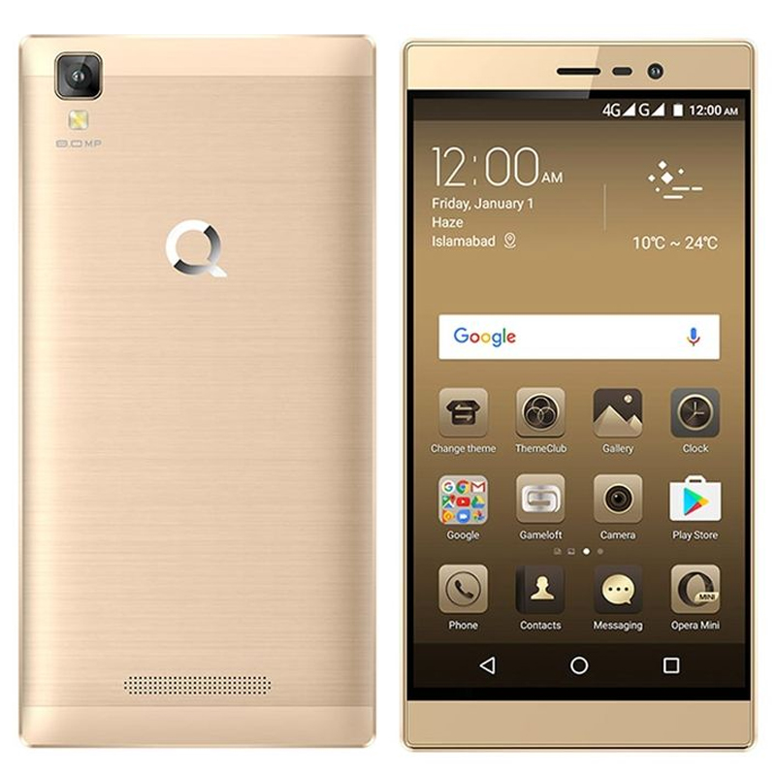
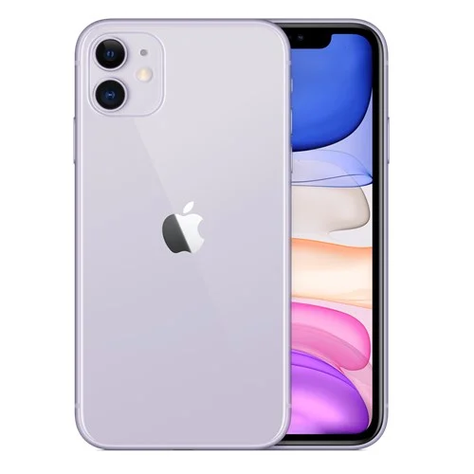
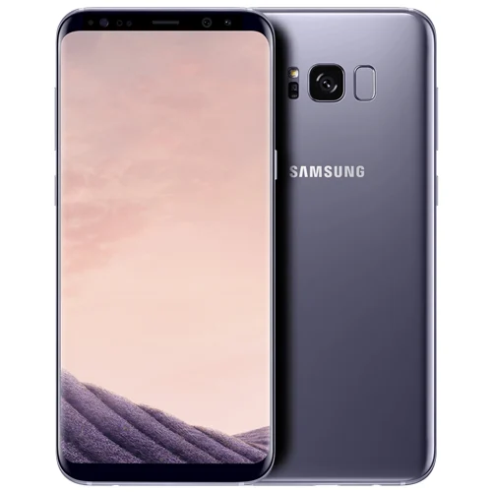
STATUS SYMBOL --- Brands act as status symbols for consumers, thereby providing them satisfaction and a proud feeling.

Slide 25

ANY QUESTION
You can contact me at: asadali@uosahiwal.edu.pk
Your query will be answered within one working day.

